Slide 1
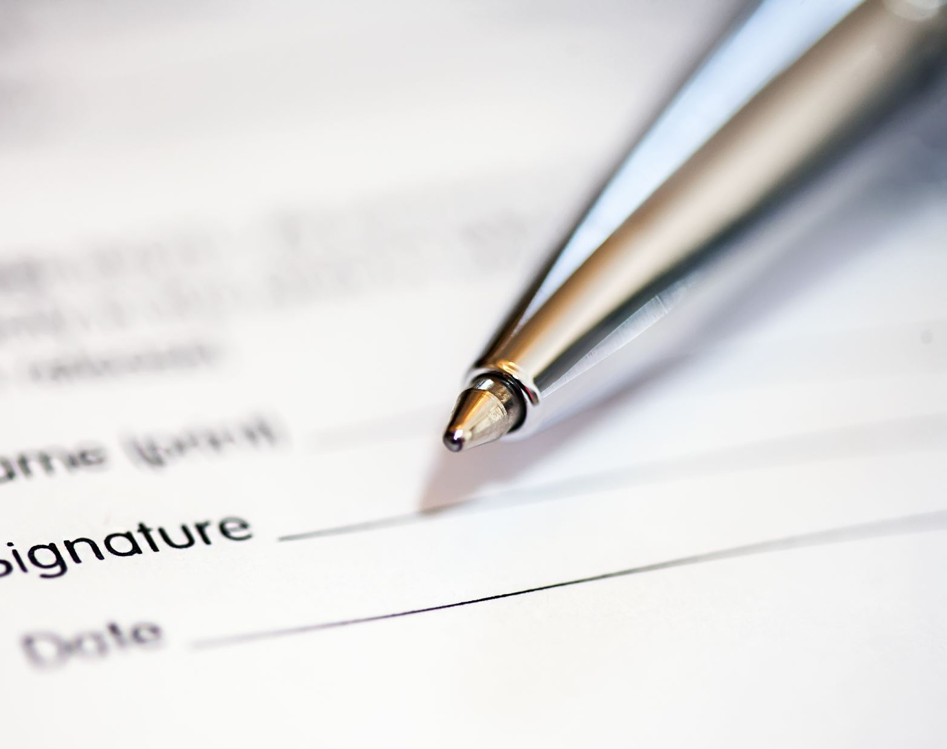
TO-DO-LIST APPLICATION

Slide 2
INTRODUCTION
Some undergraduate students are struggling to prioritize their tasks and assignments and I feel that a To Do List application would help them. The features of the application include user account ,login / logout , add / edit / delete tasks ,List tasks ,Label tasks (e.g. by priority, topic, type etc.)
After the user is authenticated, he will be redirected to the login page where user can add the tasks based on the category and give priority to the task, the application by default displays the tasks based on the due date and priority.
If the task is completed the application gives us the information about the incomplete tasks which needs to be completed.
So, it makes sure that students can have an exact track of the things they are doing and prioritising them so that they can have clear idea about the tasks.

Slide 3

FEATURES
Login
Logout
Registration
Creating and Adding tasks
Edit and delete tasks
Categorizing tasks
Prioritizing tasks
Marking tasks as completed
Exporting tasks to a file

Slide 4

SOFTWARE AND HARDWARE REQUIREMENTS
SOFTWARE REQUIREMENTS
Operating System - Windows 8 or above
Framework - Django
Language – Python
HARDWARE REQUIREMENTS
Processer - Intel-i5
Ram - 4GB
Storage – 256GB

Slide 5

DJANGO FRAMEWORK
Django is a high-level Python web framework that encourages rapid development and clean design. It takes care of much of the hassle of the web development, so you can focus on writing your code.
Django is used to build almost any type of website and can deliver content in almost any format.
It's free and open source
This application is built by using Django version 4.1.7
It is fast and secure.

Slide 6
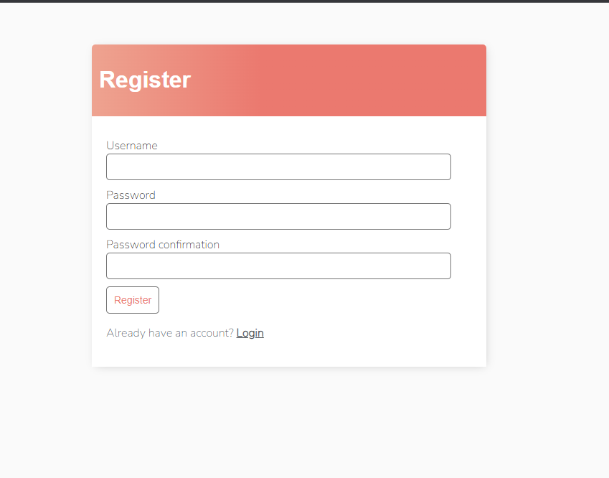
REGISTRATION PAGE
For a new user to register he should create an account.
As per default django administration the password should contain minimum 8 characters and should not be part of user name .
After registration the user will be redirected to login page.

Slide 7
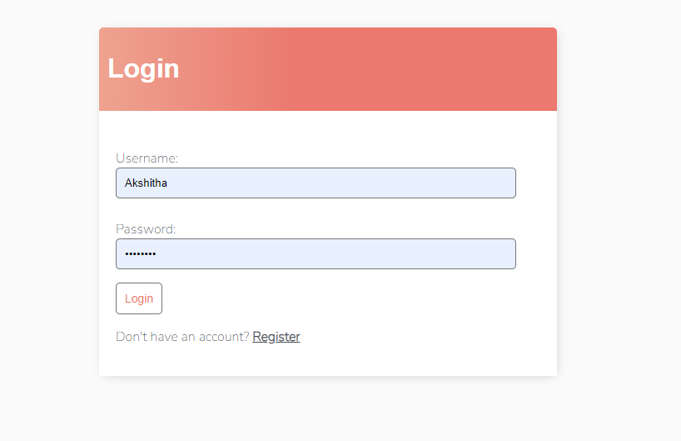
LOGIN PAGE
For the user who already has user credentials he can directly log in to the application and the data which he have created will be saved automatically.

Slide 8
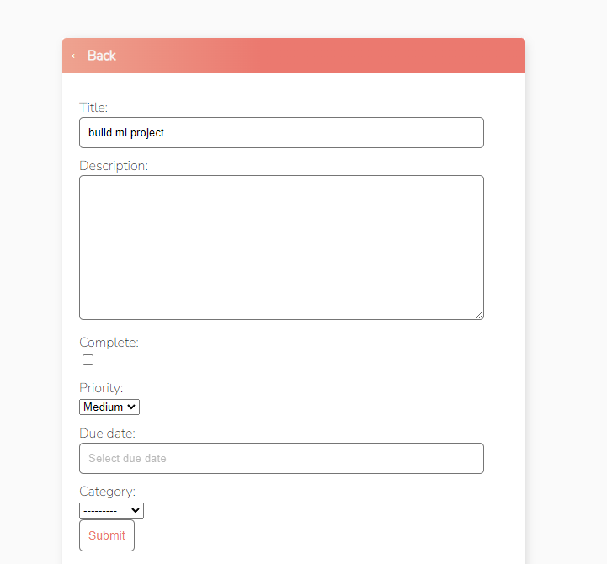
ADD TASK
To add task the user provides information like title, description, the date of submission, the category which it belongs to and its priority.
Clicking on submit will add task to application.

Slide 9
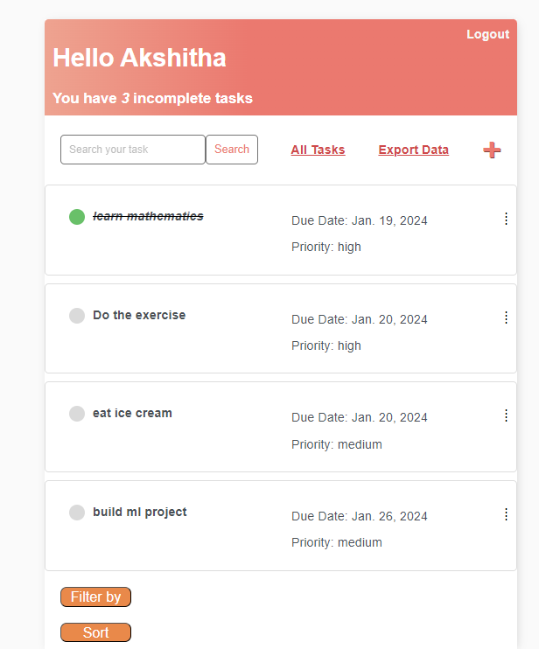
TASK COMPLETION
If a task is completed the user can click on the complete icon.
The task gets striked off from the application and the remaining tasks will be displayed as incomplete tasks in our application.

Slide 10
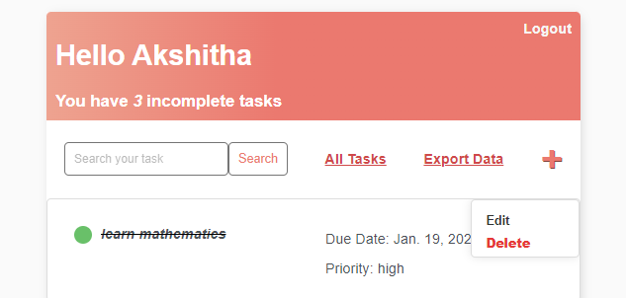
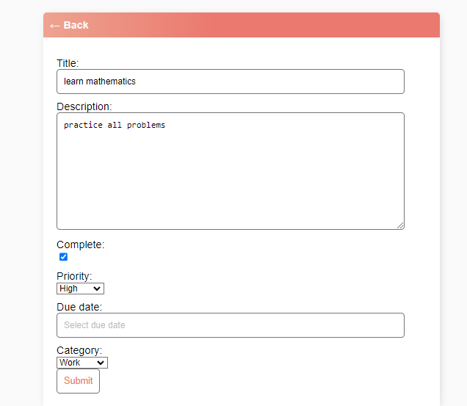
EDITING TASK
If you click on edit a task , that particular task will be opened and we can edit all the fields which the user wants to edit.
Submitting the task will reflect the changes you have made.

Slide 11
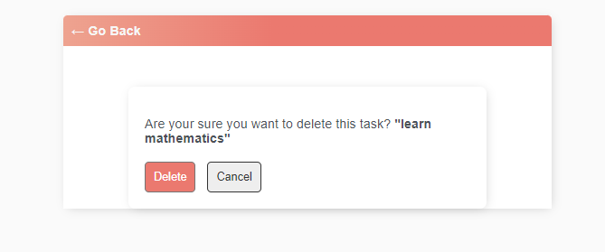
DELETING TASK
If you select a task and click on delete then the application asks whether you are sure to delete a task or not
Clicking on cancel will get back the user to the application.
Clicking on delete will delete the task from the application.

Slide 12
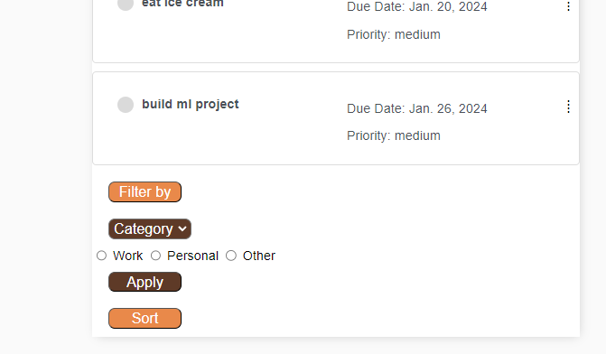
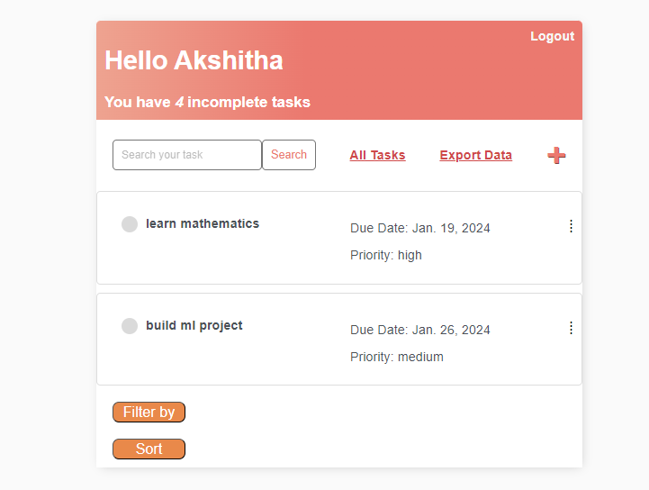
CATEGORY BASED FILTERING
This does filter based on category and priority.
In the above picture I have selected category as work and it selects the tasks which are labelled under work category.

Slide 13
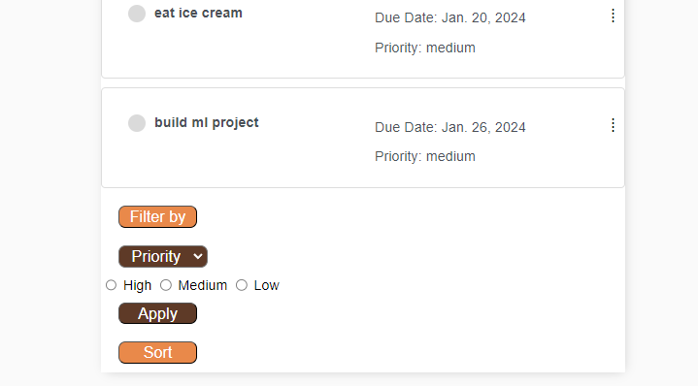
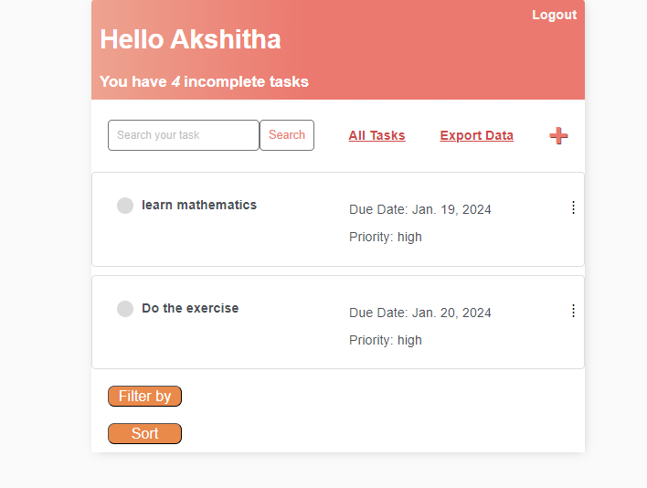
PRIORITY BASED FILTERING
This does filtering based on priority where the priority of the tasks is labelled as High, medium and low
In the above picture I have selected priority as High and it selects the tasks which are labelled under work high priority.

Slide 14
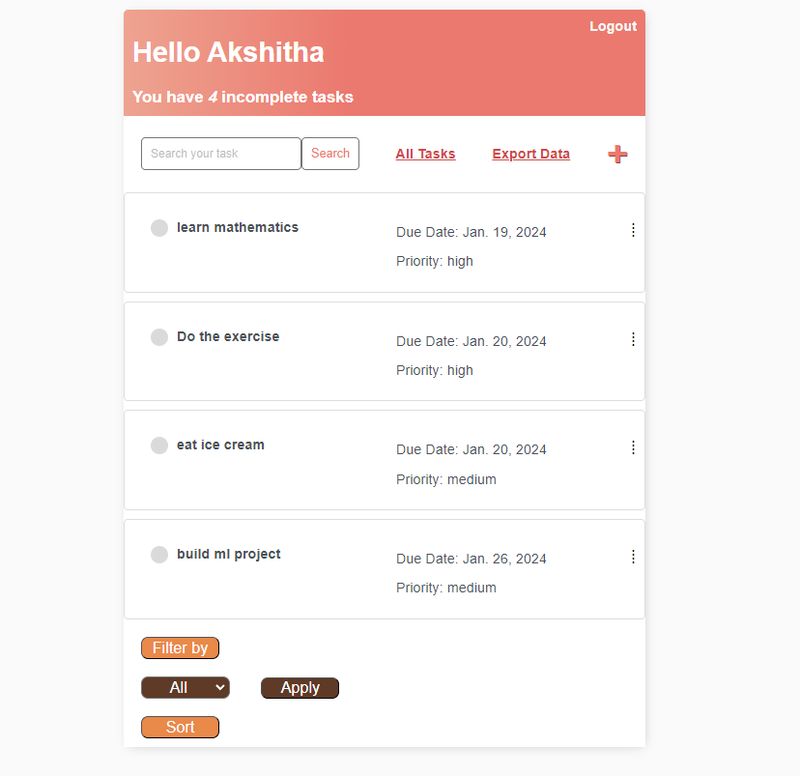
APPLY ALL
Applying All helps us to remove all the filters and displays the list of all tasks which are present in the application.

Slide 15
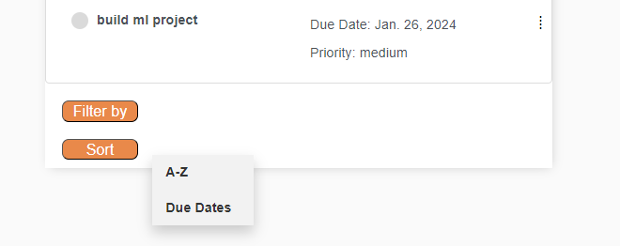
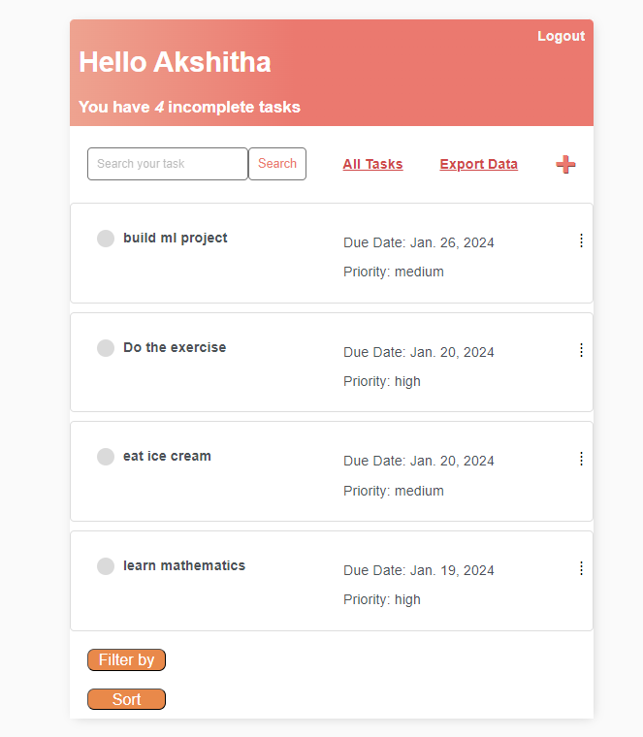
SORT ALPHABETICALLY
Clicking on Sort asks the user whether to sort the tasks alphabetically or to sort the tasks based on the due dates.
The below output sorts the tasks alphabetically.

Slide 16
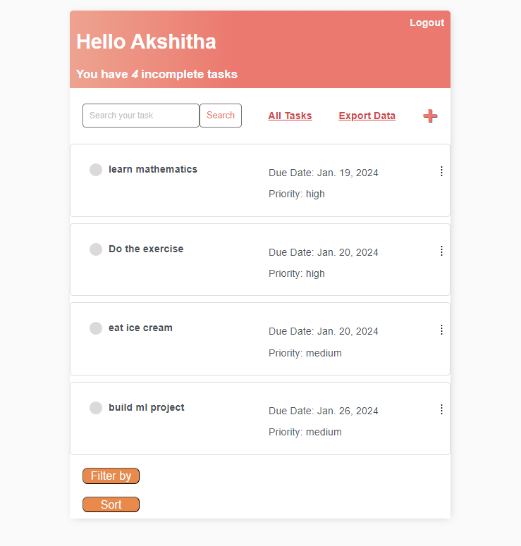
SORTING BASED ON DUE-DATE
Sorting the tasks based on due dates will display all the tasks whose deadlines occurs first followed by the tasks whose deadline occurs last
If the two tasks has the same deadline then the tasks whose priority is high gets displayed first followed by medium and then low.

Slide 17
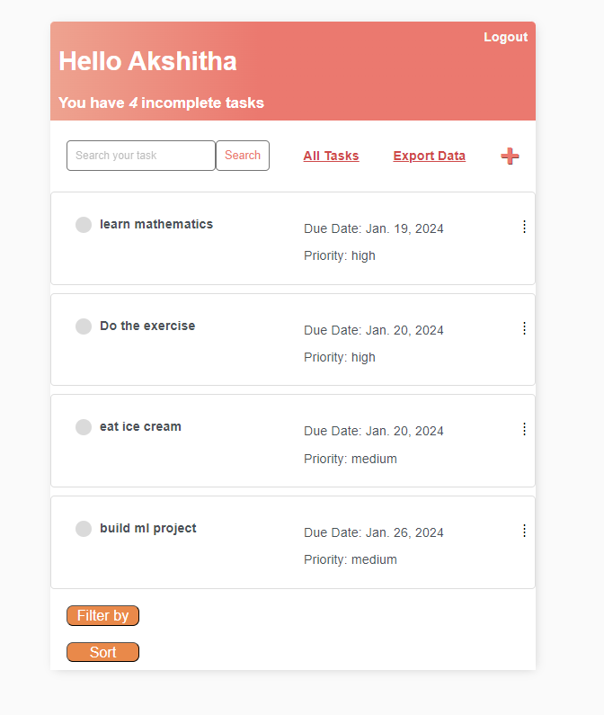
ALL TASKS
Clicking on 'All Tasks' will display the list of tasks which are by default in the application.
This removes all the filters applied and all the sorting techniques applied and displays the list of tasks.

Slide 18
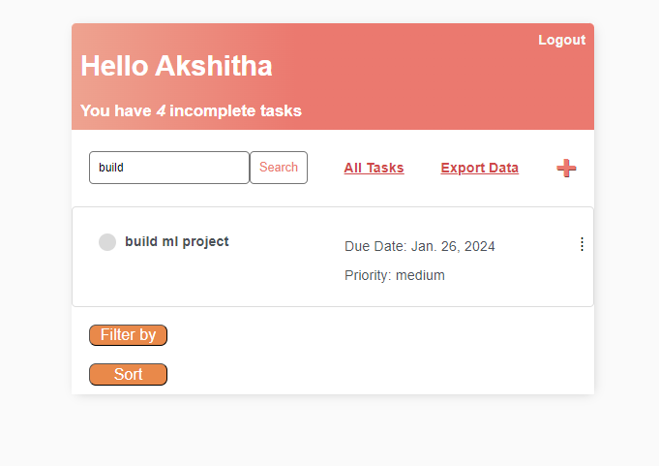
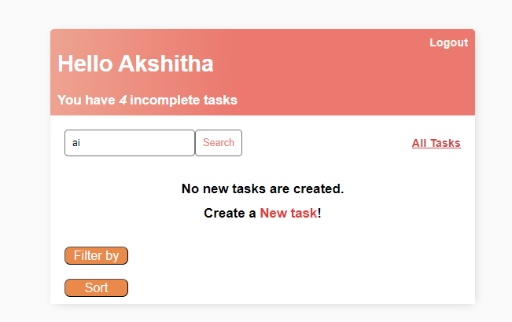
SEARCH FUNCTIONALITY
The search functionality will search the tasks based on the name of the task.
Even if the user enters the first letter of a task then the tasks which starts with that letter gets displayed
If the task you have searched is not available then the application will ask the user to create a new task.

Slide 19
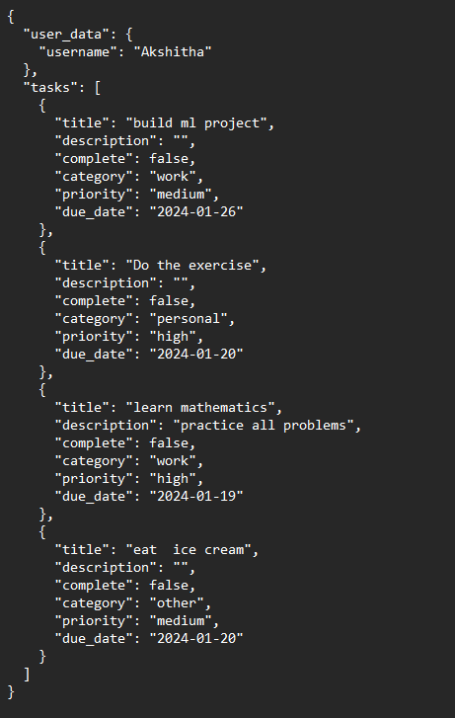
EXPORT DATA
Export data will convert the information in our application to JSON format.
It shows the information about the user, tasks created by user, title of task, description, whether the task is completed or not, category of the task and its priority.

Slide 20

THANK YOU

